Slide 1
Dairy health and nutrition
Dr Rivkeh Haryono
Senior Nutrition Scientist
SEA Scholarship Program 2026

Slide 2
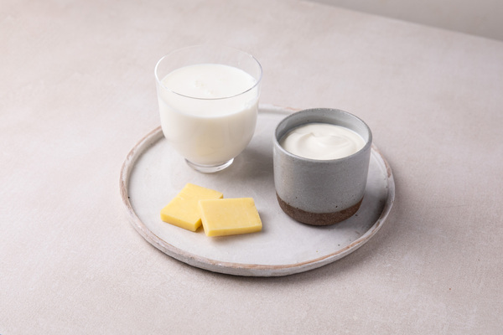
Why health and nutrition?
Health and nutrition is an important part of the dairy story
Food choices are influenced by more than just price and availability – nutrition is no longer a ‘nice to have’
Lots of misinformation about milk, cheese and yoghurt!

Slide 3
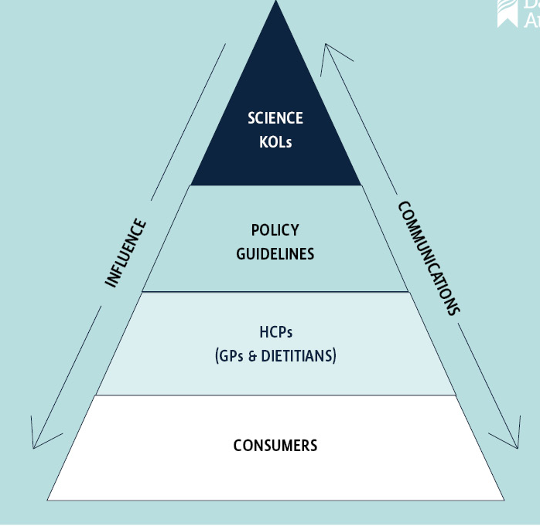
Our Health and nutrition program
Our aim is to ensure dairy foods continue to be recognised as part of healthy and sustainable dietary patterns by Key Opinion Leaders and Health Care Professionals by:
Monitoring the scientific evidence
Communicating the evidence
Addressing key barriers
Responding to the policy and regulatory environment

Slide 4
What’s so special about dairy and nutrition?

Slide 5
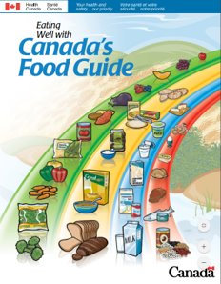
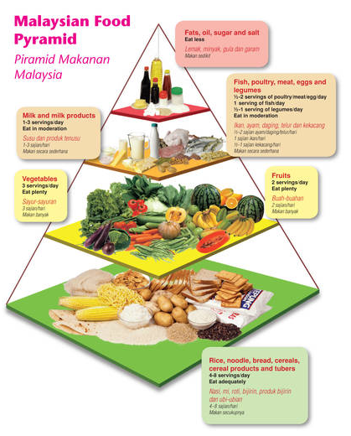
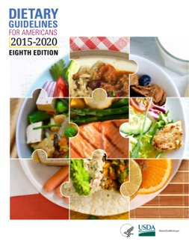
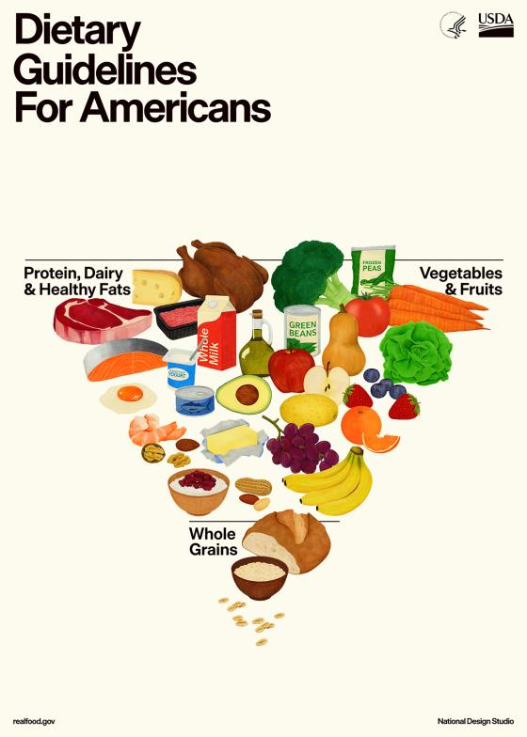
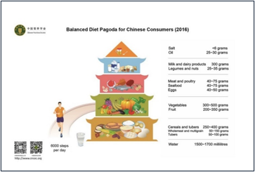
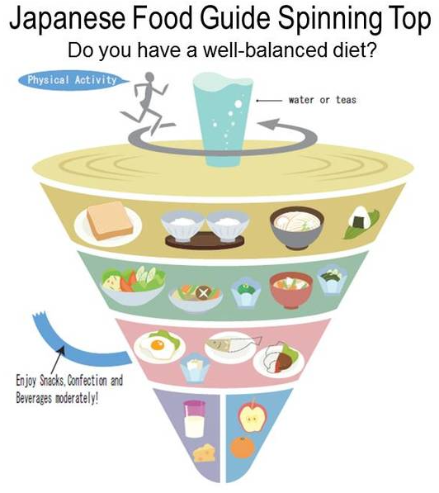
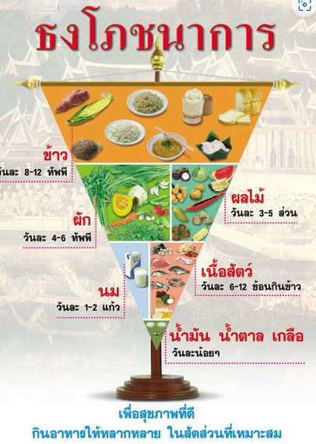
Dietary guidelines around the world recommend dairy foods

Slide 6
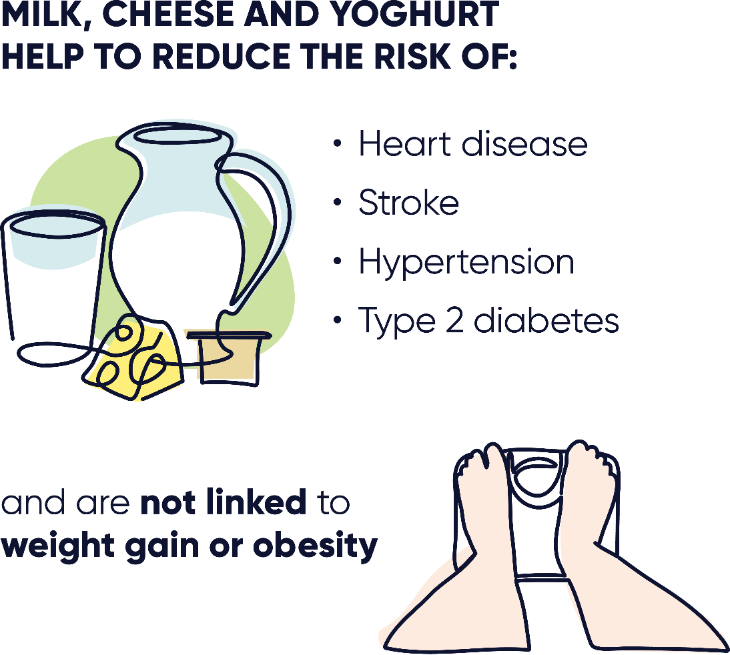
DaIRY foods are more than just calcium
High-quality protein
Carbohydrate
Calcium
Iodine
Magnesium
Zinc
Riboflavin
Phosphorous
Potassium
Vitamin A
Vitamin B12

Slide 7
The dairy matrix
Milk, cheese and yoghurt each have a distinct physical structure and nutrients they contain.
Vitamin B12
Protein
Phosphorus
Vitamin A
Saturated
Fat
Salt
Dairy's unique blend of nutrients, when consumed together, has been linked with neutral or positive health effects.
Calcium
7

Slide 8
Reasons for dairy avoidance
50%
“Watching my weight”
35%
“Due to saturated fat”
20%
“Dairy doesn’t agree with me”
29%
“Dairy makes me feel bloated”
2009
2011
2017
2024

Slide 9
Is cheese healthy?

Slide 10
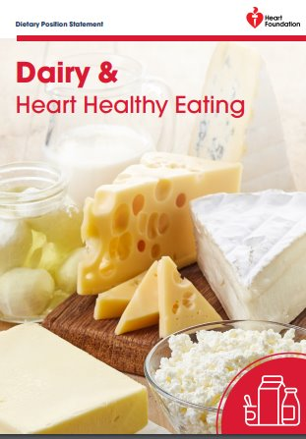
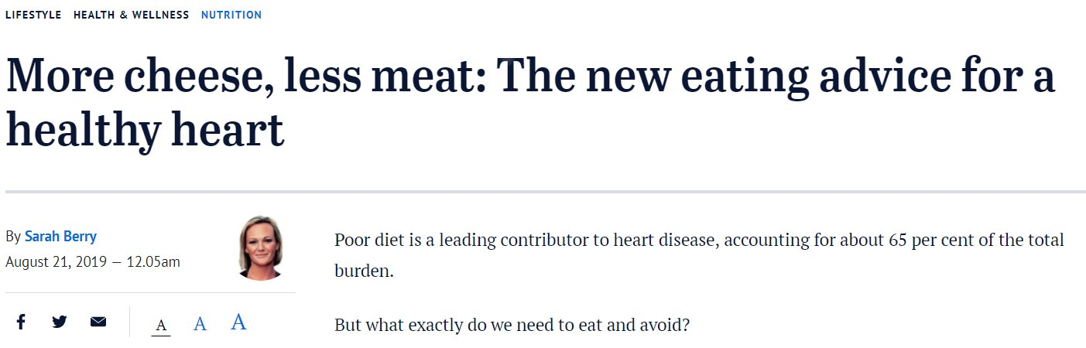
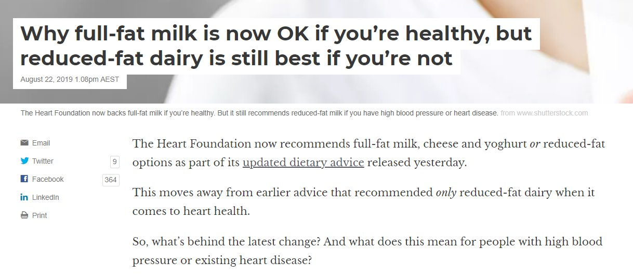
Regular or reduced fat dairy?

Slide 11
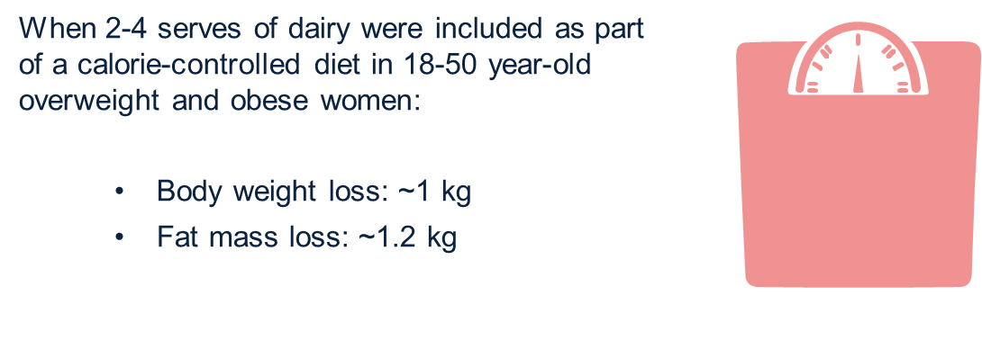
Dairy foods don’t cause weight gain

Slide 12
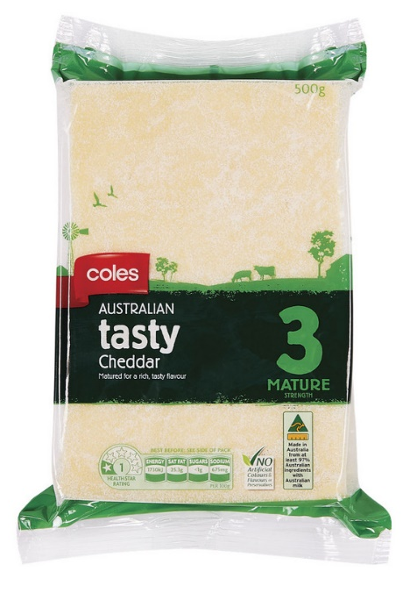

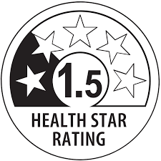
Nutrition policy doesn’t always represent core foods as healthy

Slide 13
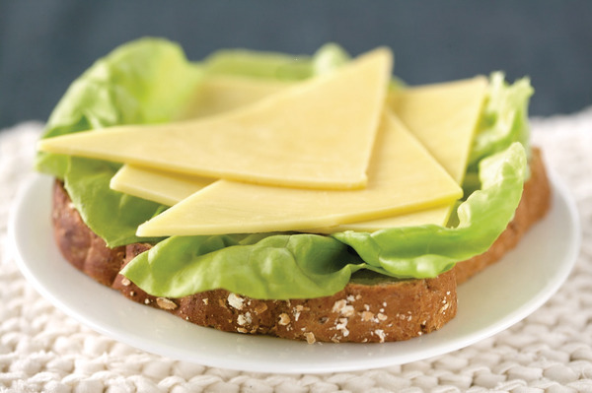
Processed cheese vs natural cheese
 | Natural cheese | Processed cheese
Ingredients | Four simple ingredients: Milk, starters, rennet, salt | Mix of blended natural cheese and emulsifying agents, oil, salt, sweeteners, colouring agents and/or flavourings depending on product
Nutrition | Source of high-quality protein and calcium. Contains sodium. | Source of high-quality protein and calcium – levels may vary. High in sodium.
Benefits | Traditional, nutrient dense food with proven health benefits | Convenience and shelf stability

Slide 14
Can you eat dairy if you’re lactose intolerant?
Notes:
.

Slide 15
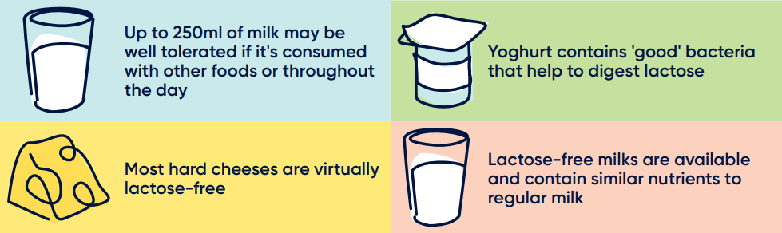
Lactose free doesn’t mean dairy free

Slide 16
We’re learning more about the health benefits of lactose
Lower GI Index compared to other sugars
Better for dental health compared to other sugars
Potential impact on calcium absorption
Satiety control
Benefits as a prebiotic for gut health

Slide 17
What’s better – dairy or plant based?

Slide 18

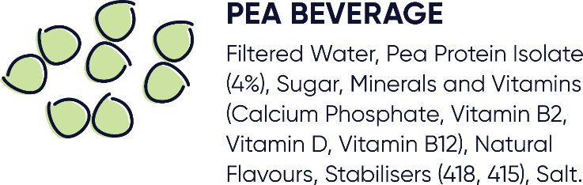
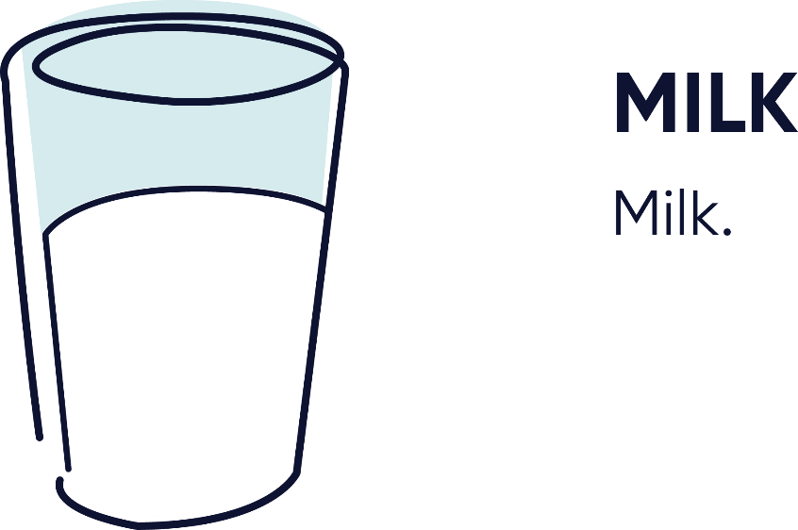
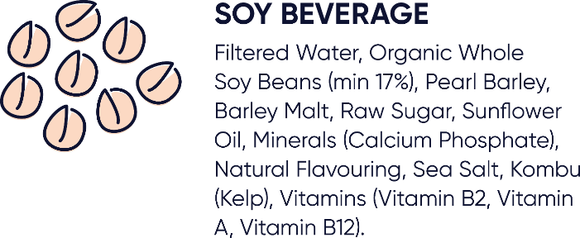
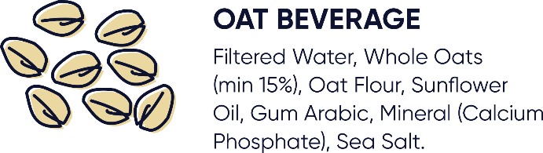

Slide 19
Health benefits of milk vs plant-based beverages
Milk | Soy | Almond | Pea | Rice | Oat
Reduced risk of Type 2 diabetes | Some heart health benefits | ???? | ???? | ???? | ????
Reduced risk of stroke | May help with menopausal symptoms
Reduced risk of hypertension
Reduced risk of heart disease
Not linked to overweight or obesity
Documented benefits for improved bone health
Documented benefits for dental health
Notes:
We don’t know long term effects of consuming some plant-based beverages like we do for consumption of milk

Slide 20
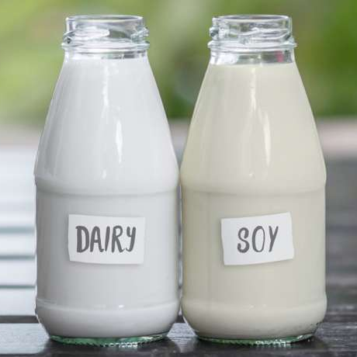
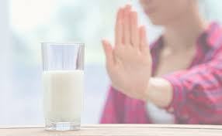
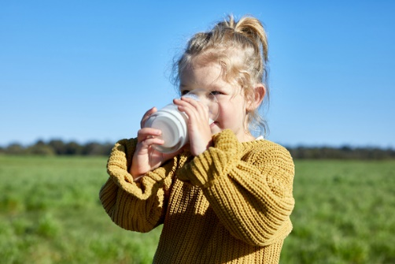
Plant-based may not be the healthiest for children
Children who consume plant-based beverages may have a lower BMI, height and micronutrient intake compared to those who consume milk
If not consuming dairy, fortified soy beverage can be helpful for calcium intake, but doesn’t contain the same package of nutrients as milk
Much more research is needed, but is growing in this space
20

Slide 21
summary
Dairy foods have a positive and unique story to tell when it comes to health and nutrition
The Dairy Matrix helps explain these benefits
Cheese is a healthy food and dairy foods are associated with a healthy weight
You can include dairy foods in the diet, even if you have lactose intolerance
Plant versus animal foods is a hot topic – we know dairy foods are a key source of nutrition and important to include in a healthy diet.

Slide 22

Thank you!

