Slide 1
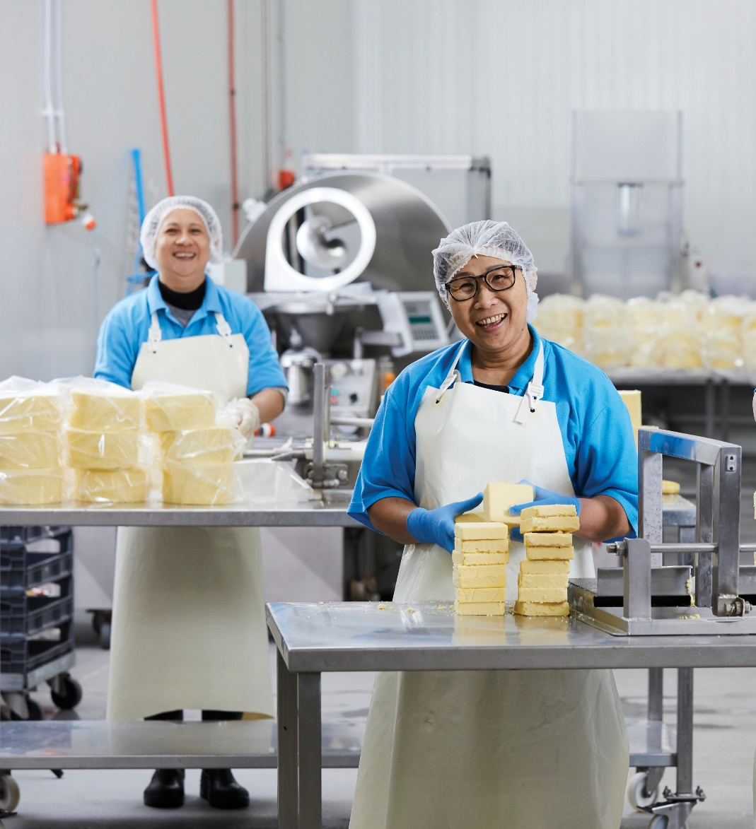



Month 202X

Slide 2
Dairy food safety overview
2026 South East Asia Scholarship Program
Stewart Davey – Technical Market Assurance Manager
Dairy Australia

Slide 3
WHAT DO WE MEAN BY FOOD SAFETY?
Food is not safe if it would be likely to cause physical harm to a person who might later consume it

Slide 4
RISKS TO FOOD SAFETY
Microbial
Chemical
Physical

Slide 5
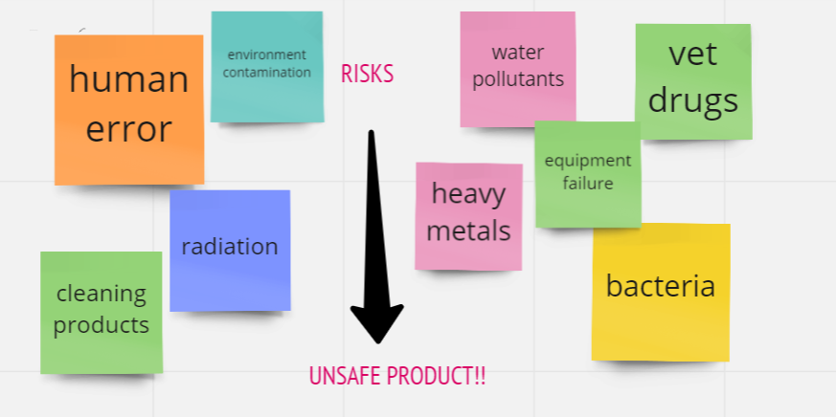
A Few Examples……

Slide 6
Food Safety Video

Slide 7
Regulatory framework
Federal
State
Certify
Exports for overseas governments/markets
Develop
National Food Safety Policy and Standards
Implement
National Food Safety Policy and Standards
Department of Agriculture & Water Resources
Export documentation, compliance to foreign standards
Negotiation of trade agreements
Registration of Ag & Vet chemicals,
Animal health and welfare
Food Standards Australia New Zealand (FSANZ)
Manages development and review of foods standards for locally manufactured and imported foods
Develops Recall protocols, and coordinates any product recalls when necessary.
State Dairy Food Authorities
Registration/licensing of farms, factories, warehouses,
Farm, factory and warehouse audits
Monitors milk quality-Australian Milk Residue Survey (AMRA).
Environmental Protection Authorities monitor conformance to standards for water, air, and waste.

Slide 8
Food Standards Development – Collaborative Process
Consumers
Development of Food Standards is a collaborative process with input from multiple stakeholders.
Result is a system owned by the industry and largely industry self managed.
Federal Government Agencies
Manufacturers
FSANZ Food Standards
Industry Groups (including Dairy Australia)
Codex, Alimentarius, WTO, WCO
State Dept’s of Primary Industries
State Dairy Food Authorities

Slide 9
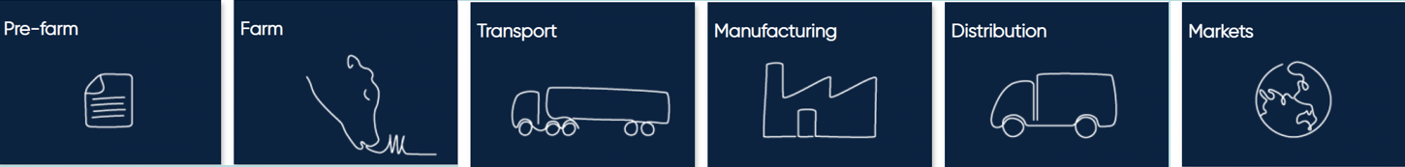
Food safety in the supply chain
Animals
Water
Chemicals
Feed
Premises
Equipment
Milking practices
Cleaning
Milk storage
Staff/Training
Hazard control
Traceability
Time/Temp control
Staff/Training
Milk
Ingredients
Water
Packaging material
Equipment
Cleaning
Skilled Staff
Traceability
Traceability
Temperature
Cleanliness
Traceability
Food fraud
Recall
Product handling

Slide 10
Food safety in the supply chain
These must have an approved Food Safety Plan. They are audited and are the basis for domestic licensing, and export accreditation.

Slide 11
Questions

Slide 12
Thank you

