Slide 2

Food Regulatory Framewoks in Australia
Southeast Asia
Scholarship Group
2026
Presented by Adriana Hincapie
R&D Manager – Regulatory and Nutrition
Lactalis Australia Pty Ltd
29th January 2026

Slide 3
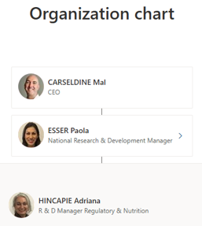
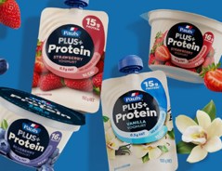
Adriana Hincapie
R&D Manager – Regulatory and Nutrition
Lactalis Australia Pty Ltd
adriana.hincapie@au.lactalis.com
Mob: +61 417672742
www.linkedin.com/in/adriana-hincapie-271a0372​
Milk & Beverages
Yoghurts & Desserts
Cheese & Ingredients
Packaging

Slide 4
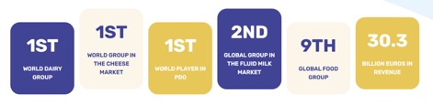
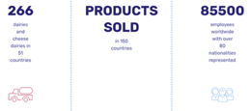
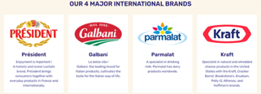
Groupe Lactalis
Global positioning
Key figures
The 4
major brands

Slide 5

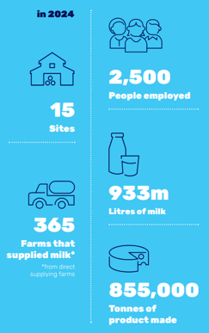


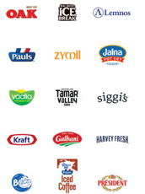
Lactalis Australia
Our proud local heritage and traditions began with the original Pauls milk business in the 1930s.
Manufacturing sites in every state

Slide 6
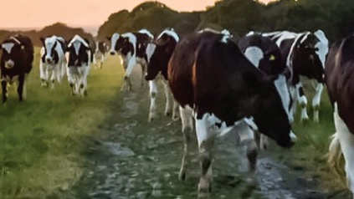















DaIry Australia SEA scholarship presentation Topics
National Trade Measurement Regulations
Overview of Regulatory Frameworks covering the Food Industry
2. Food Standards Australia New Zealand (FSANZ) and the Food Standards Code
5. Department of Foreign Affairs & Trade (DFAT)
6. Department of Agriculture, Fisheries & Forestry (DAFF)
3. The Australian Competition and Consumer Commission (ACCC)
7. The interaction between Regulators
Presented by Adriana Hincapie R&D Manager Regulatory & Nutrition Lactalis Australia Pty Ltd 29th January 2026

Slide 7

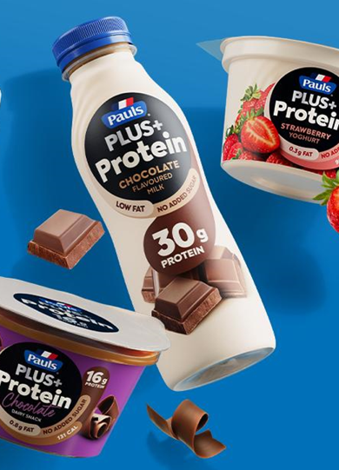
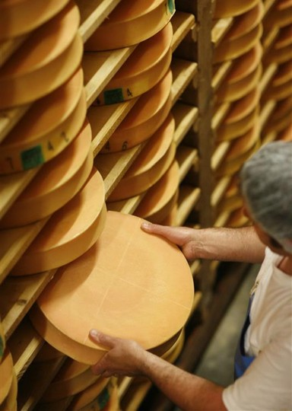
Australia’s food regulatory and trade ecosystem
involves multiple agencies working together to ensure compliance, consumer protection, and international trade integrity.

Slide 8
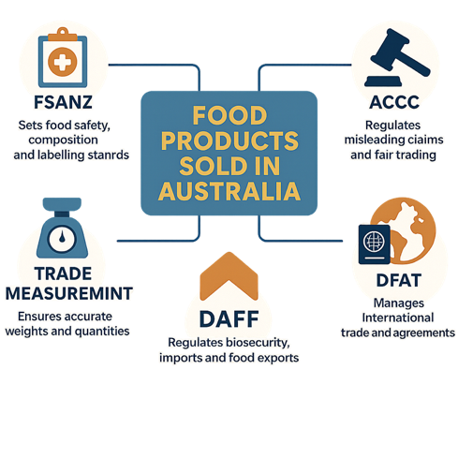
The Australian Food Regulatory Ecosystem

Slide 9
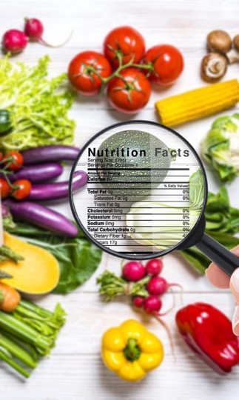
1. Food Standards Australia New Zealand
FSANZ
Sets food standards that support a safe and trusted food supply.
Bi-National Food Authority
  A treaty-level agreement between Australia and New Zealand to set and maintain trans-Tasman food standards.
  It is an independent statutory authority in the Australian Government Health and Aged Care portfolio.
  Operates under the Food Standards Australia New Zealand Act 1991 (FSANZ Act).
  Responsible for setting food standards, including composition, safety, and labelling requirements, ensuring safe food supply and public health.

Slide 10

Food Composition Standards
Food composition eg: Milk, Cream, Cheese, Fermented dairy
Contaminants and residues; MRLs
Novel foods and new technologies
Food labelling standards
Ingredient lists
Allergen declarations
Nutrition Information Panels
Health and nutrition claims
Advisory statements and warnings
Provides scientific advice to government
Food safety Standards
Consumer confidence in the quality and safety of food produced, processed, sold or exported from ANZ
Aligning, harmonisation with international best practices
Incidents and recalls
Emerging food risks
Nutrition policy
International standards
Consumer information
FSANZ Food Standards Code: A world-leading standard
legally enforceable
All food sold in Australia and New Zealand must comply with food standards

Slide 11
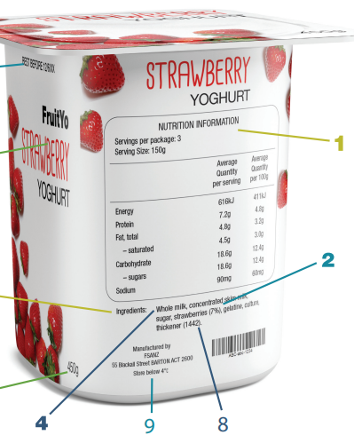
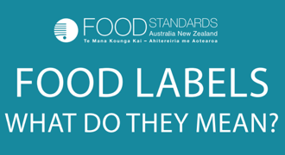
CONSUMER INFORMATION https://www.foodstandards.gov.au/sites/default/files/2023-11/food%20label%20poster%20%281%29.pdf

Slide 12
Food Safety Standard Levels
FSANZ – develops and maintains Food Standards – independent , science, risk.
Certifying bodies / Global Standards – eg: FSSC 22000; BRC.
Customer Standards – Private Label
Company Policy and Standards
State/Territory Government Authorities (eg: Safe Food Qld, NSW Food Authority, Dairy Food Safety Vic.) enforcement + other Food Safety Regs

Slide 13

2. Australian Competition and Consumer Commission (ACCC)
Enforces the Australian Consumer Law (ACL), contained in Schedule 2 of the Competition and Consumer Act 2010, across all industries including:
  food manufacturing,
  importing,
  retailing.
Operates alongside food safety and composition laws.
Focuses specifically on fair trading and consumer protection.
Focuses on consumer perception and fairness, not whether a food is safe or nutritious.

Slide 14
Core consumer law obligations for food manufacturers
Consumer deception and unfair practices
Misleading or deceptive conduct
Food manufacturers must not engage in conduct that misleads or is likely to mislead consumers, regardless of intention.
This applies to:
  Product labels and packaging
  Marketing and advertising
  Websites and social media
  Health, nutrition, sustainability and origin claims
False or misleading representations
This includes representations about:
  Ingredients or composition
  Nutritional benefits
  Country of origin
  Suitability for dietary needs
  Environmental or sustainability benefits
Claims must be true, accurate, and supported by evidence at the time they are made.
NOTE: Even technically accurate statements may breach the law if the overall impression is misleading.
Imagery or wording may still contravene the ACL.

Slide 15

Environmental and sustainability claims
“Greenwashing”
A current ACCC enforcement priority. Risk areas include “green” claims on:
“Sustainable”, “eco-friendly” or “carbon neutral”
Packaging recyclability - APCO + Targets
Ethical sourcing
Animal welfare representations
Claims must be: Specific (not vague), substantiated by evidence, not overstating benefits. Must be strictly substantiated and documented before launch.
Credence Claims (claims consumers cannot readily verify) can justify higher prices, influence purchasing behaviour disproportionately.

Slide 16
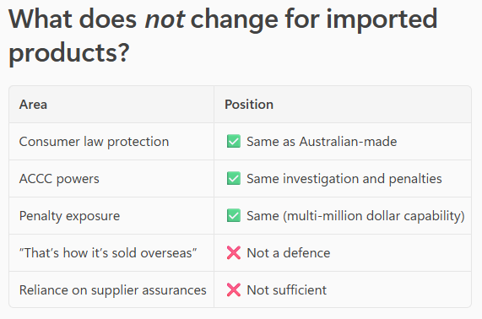
Do ACCC consumer law rules apply to imported food products?
✅ Yes — fully
ACL applies to all goods sold in Australia
Including food products manufactured overseas and imported for sale
Enforcement actions apply the same way
Consumers are protected regardless of the product’s country of origin

Slide 17
ACCC
Who is legally responsible under Australian law?
The Australian business that imports the food is often treated as the “manufacturer” for legal purposes, even if the actual factory is offshore.
In ACCC investigations, the regulator will usually pursue:
  The Australian importer
  The Australian brand owner
  The local distributor or retailer
  Not the offshore factory!

Slide 18
3. Trade Measurement Regulations for packaged foods
  Enforcing uniform measurement practices supports fair competition and strengthens consumer trust.
Legislative Framework
  The National Measurement Act 1960 and National Trade Measurement Regulations 2009 govern trade measurement standards for packaged goods in Australia.
Regulatory Authority
  The National Measurement Institute (NMI) enforces laws, maintains standards, verifies instruments, and conducts inspections nationwide.
Business Compliance
  Businesses must ensure accurate labeling of goods sold by weight, volume, number, length, or area across the supply chain.
  Trade measurement laws apply to food manufacturing, packing, importation, and retail sale.

Slide 19

Relationship with Australian Consumer Law
Australian Consumer Law Protection
  ACL prohibits misleading or deceptive conduct, including false quantity claims, protecting consumers economically.
Trade Measurement Laws Scope
  Trade measurement laws focus on ensuring the accuracy of product quantity declarations to protect consumers.
Risk of Non-Compliance
  Non-compliance can lead to fines, product recalls, and damage to business reputation.

Slide 20
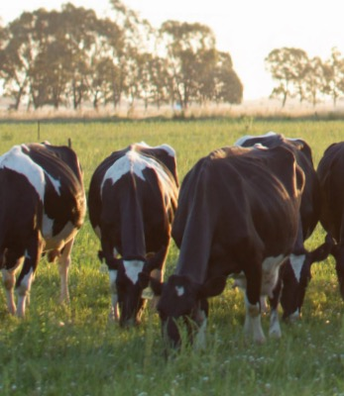
4. Department of Foreign Affairs and Trade (DFAT)
5. Department of Agriculture, Fisheries and Forestry (DAFF)
DAFF regulates the product, while DFAT regulates the trade framework.
DFAT
DAFF
DAFF controls what food can enter Australia and under what biosecurity and import conditions
DFAT sets the international trade rules under which food is traded.

Slide 21
DFAT–DAFF Interaction on Food Imports into Australia
DAFF – Dept of Agriculture, Fisheries and Forestry
Role: Biosecurity and imported food control
DFAT – Dept of Foreign Affairs and Trade
Role: International trade framework for food
✅ DFAT opens the door commercially
✅ DAFF decides how tightly that door is controlled
Negotiates Free Trade Agreements (FTAs)
Represents Australia under WTO agreements
Sets rules of origin, tariffs and sanctions
Manages government‑to‑government trade issues
Key focus:
Under what international rules food may be traded with Australia
Administers the Biosecurity Act and Imported Food Control Act Applies border inspection, sampling and testing Decides on clearance, holding, re‑export or destruction Manages food safety and biosecurity risks Key focus: Whether the specific food can safely enter Australia

Slide 22

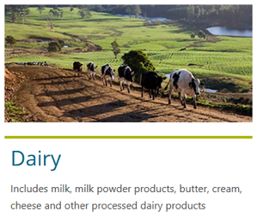
Manual of Importing Country Requirements
Requirements set by agricultural export trading partners
Requirements that exporters must meet for import into specific overseas countries.
Exporters must comply with:
  the Export Control Act and associated Rules when exporting commodities from Australia.
Establishments that require official certification must be export-registered, and
Must conform to the Approved Arrangement requirements of the
  Export Control (Milk and Milk Product) Rules 2021
  Includes the manufacturer and storage facilities.

Slide 23

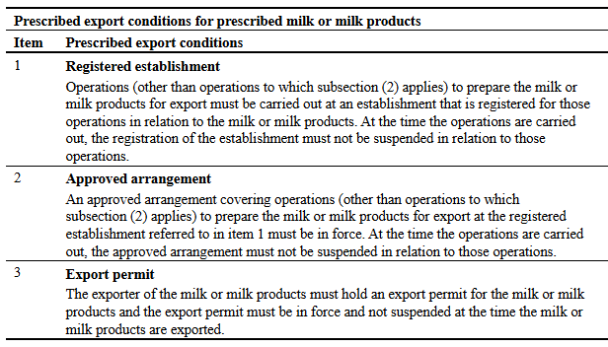
Division 2—Prohibited export and prescribed export conditions
registered establishment means an establishment that is registered for a kind of export operations in relation to prescribed milk or milk products
2‑4 Export of prescribed milk or milk products is prohibited unless prescribed conditions are complied with
(1) The export from Australian territory of prescribed milk or milk products is prohibited unless the conditions specified in the items in the following table are complied with.

Slide 24
7. The interaction between Regulators
Agency | Primary Role | Connection to Food Products
ACCC | Consumer law enforcement, fair trading | Prevents any misleading claims on quantity, quality, pricing, etc.
FSANZ | Food safety and standards | Sets nutritional and ingredient labelling requirements.
NMI | Trade measurement compliance | Ensures accurate quantity declarations and verified instruments.
DFAT | International trade and agreements | Regulates imports/exports and aligns with global standards.
DAFF | Biosecurity and imported food control requirements | Decides whether the food is allowed in and under what conditions.

Slide 25
Australia’s food regulatory and trade ecosystem
Examples
With funding from DAFF, FSANZ established the Science and Food Safety Dialogue to foster regulatory collaboration with countries in the region.
Support regulatory harmonisation and facilitate trade.
FSANZ collaborates with CODEX.
FSANZ is emergency contact point for the International Food Safety Authorities Network (INFOSAN), under the WHO and FAO.
FSANZ advises DAFF on the potential for imported food to pose a risk to public health.
DAFF determines appropriate measures to manage food safety.
The Asia-Pacific Economic Cooperation’s (APEC) Food Safety Cooperation Forum (FSCF) set up for strengthening food safety systems in the APEC region
Consumer trust in the food system, safe food, truth in labelling.
Consumer protection through robust standards and fair-trade practices.

Slide 26
Food Regulations and Industry
Exporting
Importing
Must comply with all Australian regulations
+
Regulations in country of importation
Composition
Labelling
Nutrition Claims
Ingredients / additives
UOM
Reg. Est. No.
Must comply with all Australian regulations
Biosecurity
Country of Origin
FSANZ – Labelling and composition
ACCC - Representations
NMI

