Slide 1
Australian Dairy Sustainability Framework

Slide 2





Owned by the Whole Industry
Governed by the Sustainability Steering Committee
Australian Dairy Farmers
Australian Dairy Products Federation
Australian Dairy Industry Council
Dairy Australia
DA acts as secretariat for ADSF
Notes:
DA secretariat for the ADSF

Slide 3
Purpose Statement
The purpose of the Australian Dairy Sustainability Framework is to transparently address stakeholders' sustainability expectations while ensuring industry economic viability and building capacity to deliver positive change

Slide 4

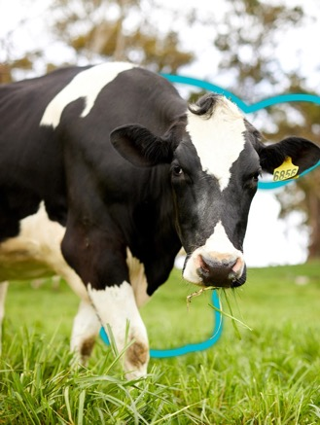
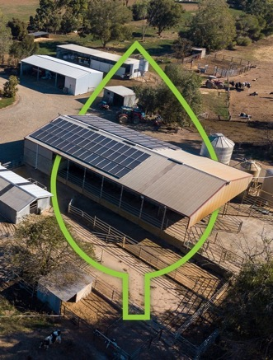
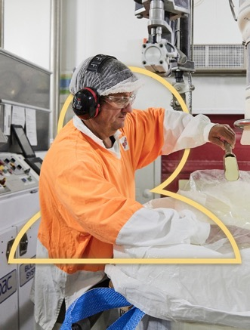
Our Dairy Promise:
To provide nutritious food for a healthier world
Enhancing economic viability
and livelihoods
Improving wellbeing
of people
Providing best care
for animals
Reducing our environmental impact
Notes:
The ADSF is our industry owned framework that sets the agenda, goals, targets and commitments for the dairy industry.
Established in 2012, we were the first agriculture industry to establish a sustainability framework
4 commitment areas – 11 goals

Slide 5
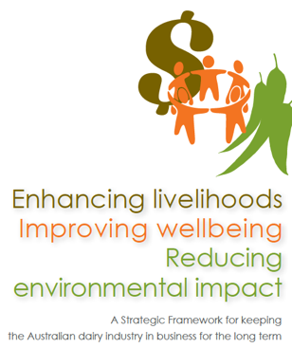


History of the ADSF
2020- Now
2012-2017
2018-2020
RL

Slide 6
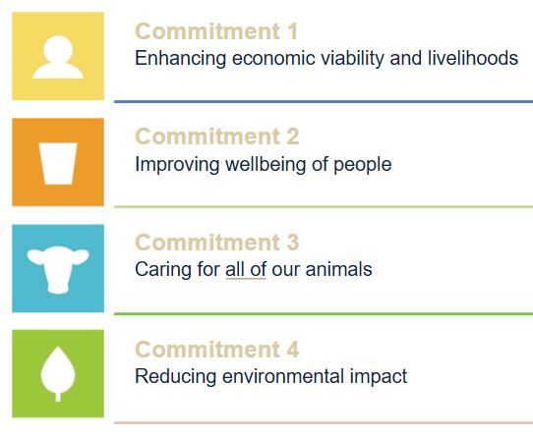




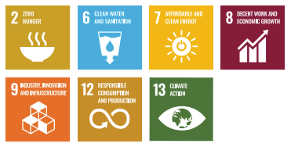

Alignment with the UN Sustainable Development Goals (SDGs)
Notes:
Aligned with SDGS and GRI reporting. Standards give the framework credibility
Mind map of all global

Slide 7
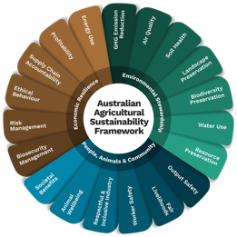











Notes:
Aligned Principles of DSF and AASF
Animal care
Biodiversity
GHG
Market development
Product safety and quality
Rural economies
Soil nutrients, quality and retention
Waste
Water
Working conditions, safety and wellbeing
Biosecurity
Profitability
Data from DMSC
Coordination with IDF, GDP, SAI, DSF on projects that align with our targets – aligned priorities and issues = coordinated efforts to common problems
Alignment with reporting standards and requirements ISO, GRI, AASB S1/2 climate-related disclosures
International Financial Reporting Standards Foundation – International Sustainability Standards Board

Slide 8
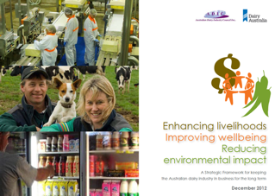
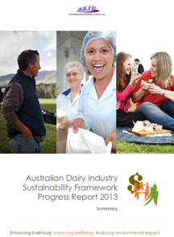
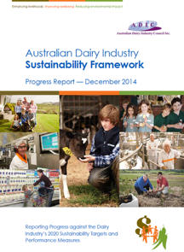
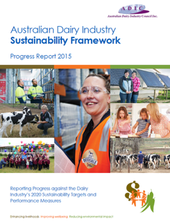
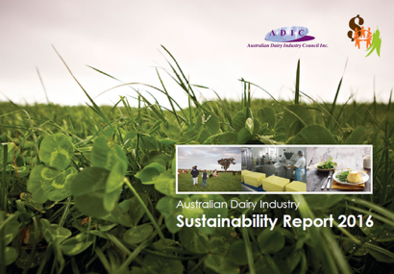
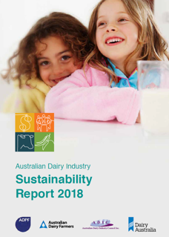
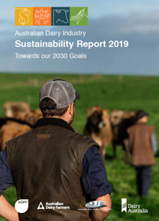
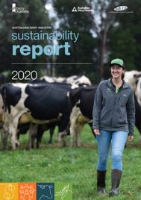
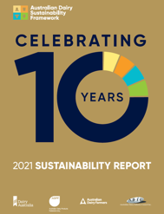
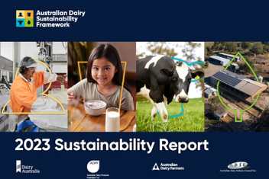
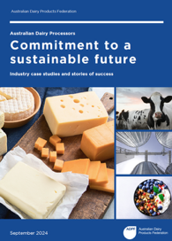
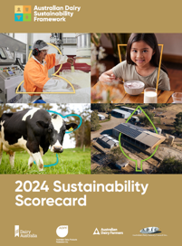
ADSF Reports

Slide 9
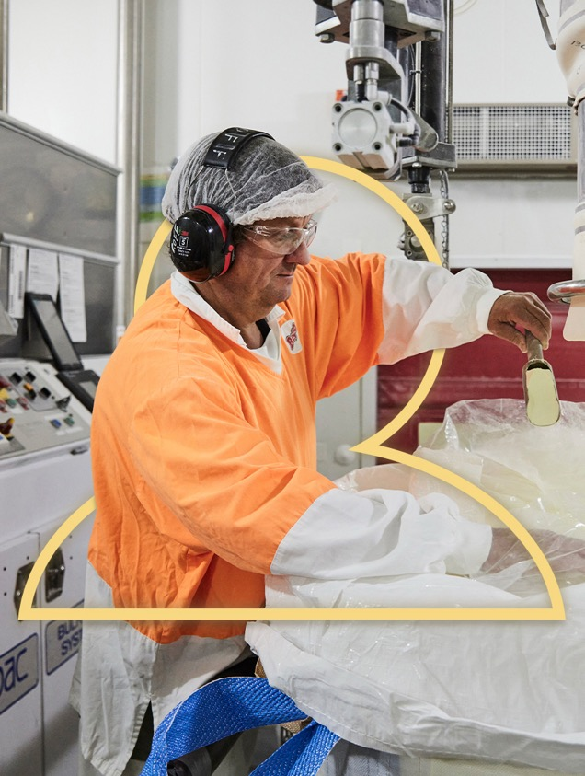
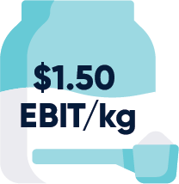



Enhancing economic viability and livelihoods
Recent highlights
More than 50% of farm businesses achieve at least $1.50 EBIT/kg MS over a rolling five year average
56% of dairy farm owners have an agreed farm transition/succession plan
78% of dairy employees are retained within the industry year-on-year
The total value of payments made to dairy farmers in Australia has increased to $6.2b in 2025
Notes:
commitment 1 aims to increase profitability for farmers and ensure industry viability– for Japan this means we will ensure safe and secure supply

Slide 10





Improving the wellbeing of people
Recent highlights
A new study finds that serving extra dairy in aged care may cut health costs
85% of Australians trust dairy as a healthy and wholesome food
80% of Australians think dairy is essential for their good health and wellbeing
No non-compliant residues were found
in Australian dairy foods, ingredients

Slide 11





Providing best care for animals
Recent highlights
A pathway into a valued market chain for surplus dairy calves has been developed
75% of consumers believe dairy farmers do a good job of caring for animals
A target for the use of antibiotics critical to humans is under development
The % of calves receiving pain relief before disbudding rose to 89% in 2022

Slide 12
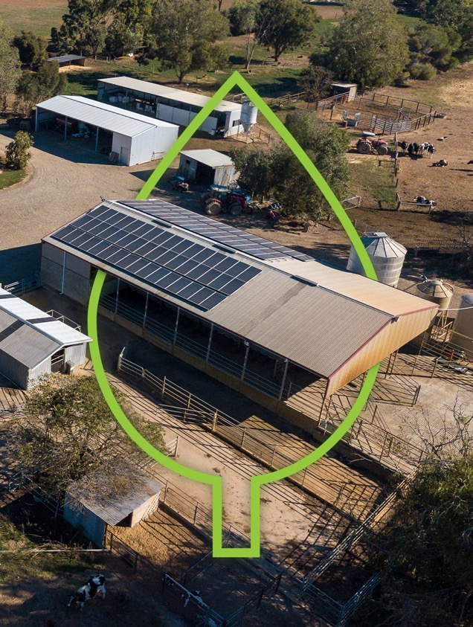




Reducing environmental impact
Recent highlights
85% of waste is diverted from landfill for dairy companies
80% of farmers recycle water from their dairy sheds
Processors on average have reduced their carbon emission by 16%
Some farmers have a GHG emissions intensity 30% lower than the average
Notes:
Data from the DMSC
Water consumption, ML of water per ML of milk produced
GHG intensity tonnes CO2e/ ML milk processed
Waste tonnes of waste diverted fom landfill per tonnes of wasted produced

