Slide 1
Doing right by our cows
Feb 2026
1

Slide 2
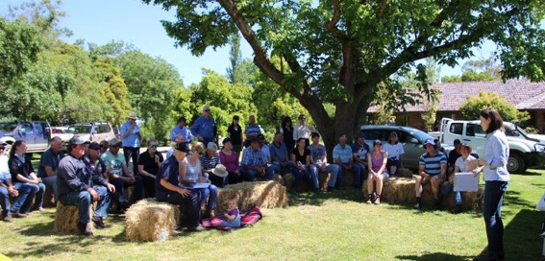
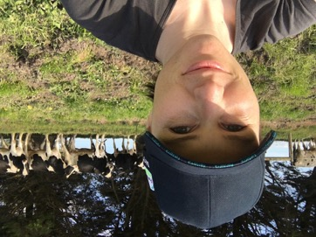
introduction
Louise Sundermann – Policy Lead Animal Health and Welfare
Notes:
- Worked at dairy Australia for nearly 10 years – starting off in the farmer ‘extension’ – training – team. Here I talking to farmers about alternative milking systems. I love getting out on farm and working with farmers and especially the cows!
- My role now is in the sustainable dairy team, working between government, industry and farmers to ensure the welfare of animals on dairy farms

Slide 3
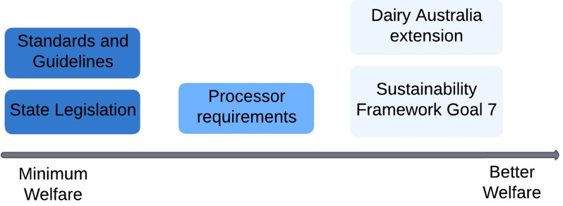
Animal welfare governance
Multiple layers of frameworks to ensure continuing improvement
Notes:
I thought is best to give you an idea of how animal welfare works in Australia, and the different layers of requirements for care on farms.
At the minimum level we have state regulations, based on the Australian Animal Welfare Standards and Guidelines for Cattle. These provide the MINIMUM requirements for care.
To sell milk, farmers will also need to meet the requirements of the milk processor they sell to, which are often above what the state requirements. These are ‘market-based’ requirements which allow the dairy processors sell milk to specific markets.
Above this is

Slide 4
Animal welfare governance
State Legislation
Processor requirements
Industry targets and extension
Most states have legislated the Australian Animal Welfare Standards and Guidelines for Cattle
Minimum legal requirements
Basic welfare:
  No tail docking
  Pain relief for dehorning adult animals
  Euthanasia with gun or captive bolt
Not required by law, but most dairy processors have some animal welfare requirements for supply, checked at audit
Most major processors have requirements for:
  Provide pain relief for all disbudding/dehorning
  Banning routine calving induction
Industry targets for welfare – not requirements
Used to guide training (extension) provided to farmers
Progress reported on regularly
4

Slide 5
Pain relief for disbudding
Notes:
75% of Victorian farmers are now disbudding with pain relief – this is from approx. 28% in 2016
DA has done a lot of comms on this topic over the last few years, and it is discussed in the popular Rearing Healthy Cavles workshops.
However other influences are:
Saputo – first with WCBF and later with MG – require pain relief for disbudding in their supply contract.
Secondly – the availability of trisolfen

Slide 6
routine Calving Induction
Data from annual veterinary survey + veterinary reports
Notes:
Australia is the last country which routine calving induction is legal, as it results in the birth of premature calves (mostly requiring euthanasia) and if done poorly, negatively impacts on the ongoing health and fertility of the cow
Industry (ADIC) committed to phase out routine calving induction in 2015, setting a limit of 15% of a herd for 2016
Producers have been reducing their reliance on induction, reducing the % of their herd induced to below industry limits
In late 2018, industry agreed to a complete phase out by 1 January 2022

Slide 7
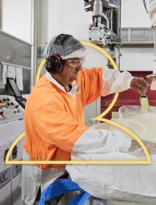

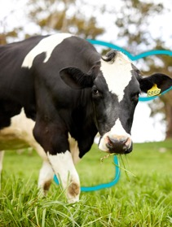
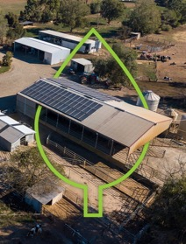
Australian Dairy Sustainability Framework Commitments
Enhancing economic viability
and livelihoods
Improving wellbeing
of people
Providing best care
for animals
Reducing our environmental impact
Notes:
Overview
>10 years old, first livestock sustainability framework
Industry owned, stewardship by DA (brief overview of SD team)
Targets haven’t been updated, current targets are outdated, soft, or already achieved
Review process undertaken 2022/23
Recent review – included:
Animal welfare researchers + experts
Farmers
Vets
Animal welfare advocates (RSPCA)

Slide 8
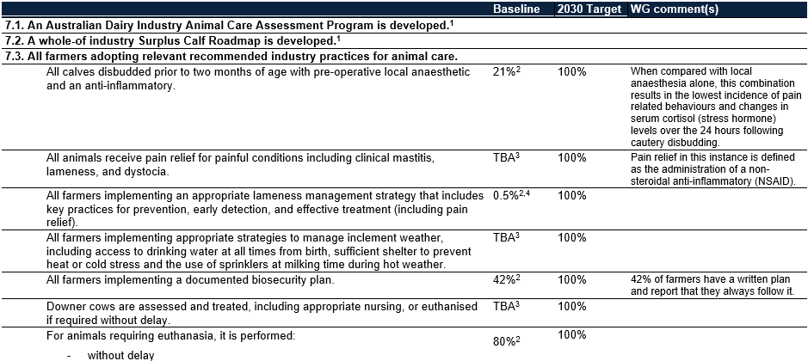
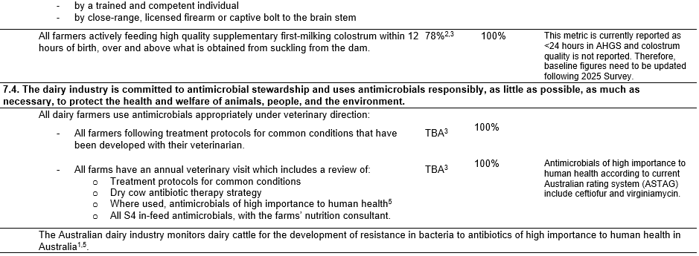
Goal 7 – Proposed targets

Slide 9

VIRTUAL FENCING
9

Slide 10
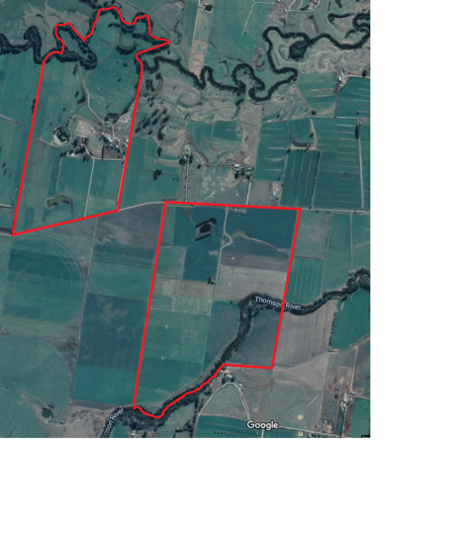
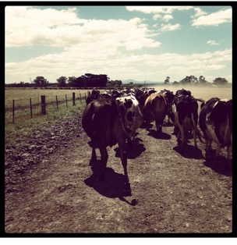
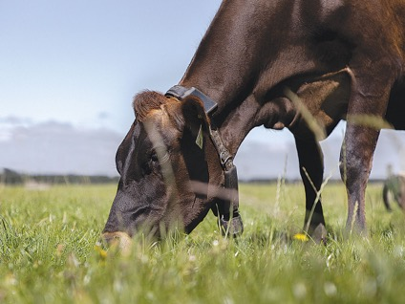
Virtual fencing
Australia dairy farms usually large, with 300+ cows walking long distances to pasture
Virtual fencing technologies have benefits of:
  Reducing lameness
  Improving pasture utilisation
  Reducing labour
Currently not legal for commercial use in Victoria
  Use electric pulse

Slide 11
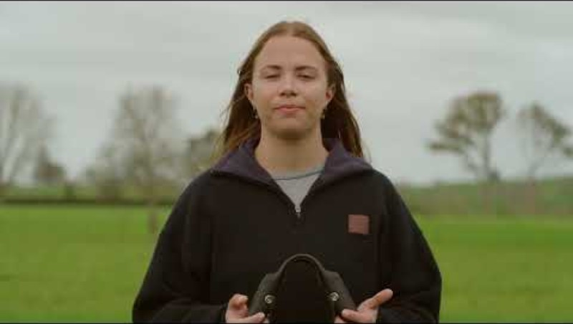
Virtual fencing

Slide 12
Virtual fencing
Currently a trail of technology at Ellinbank research farm (visit later this week)
Working with advocacy, technology firms and government for access for farmers

Slide 13
CALFWAYS
Roadmap for non-replacement calves
13

Slide 14
CURRENT PATHWAYS
Source: Meridian Agriculture. Calfways economic analysis 2024 – part 1.

Slide 15
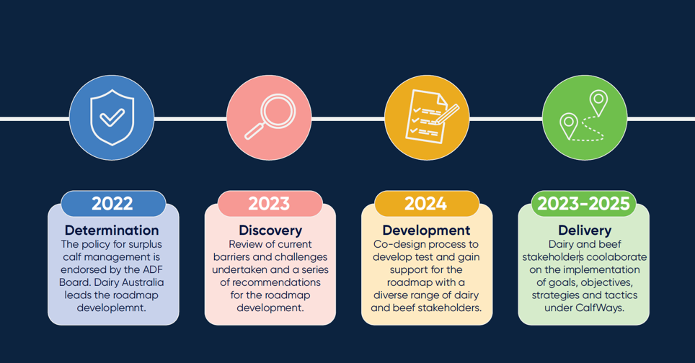
CALFWAYS TIMELINE
Notes:
Overview of process and where we’ve come from and where we are.

Slide 16
Calfways – whats next
Report Launch
Strategic Partnerships to achieve targets

Slide 17
THANK YOU
Louise Sundermann
louise.sundermann@dairyaustralia.com.au
17

